Slide 1
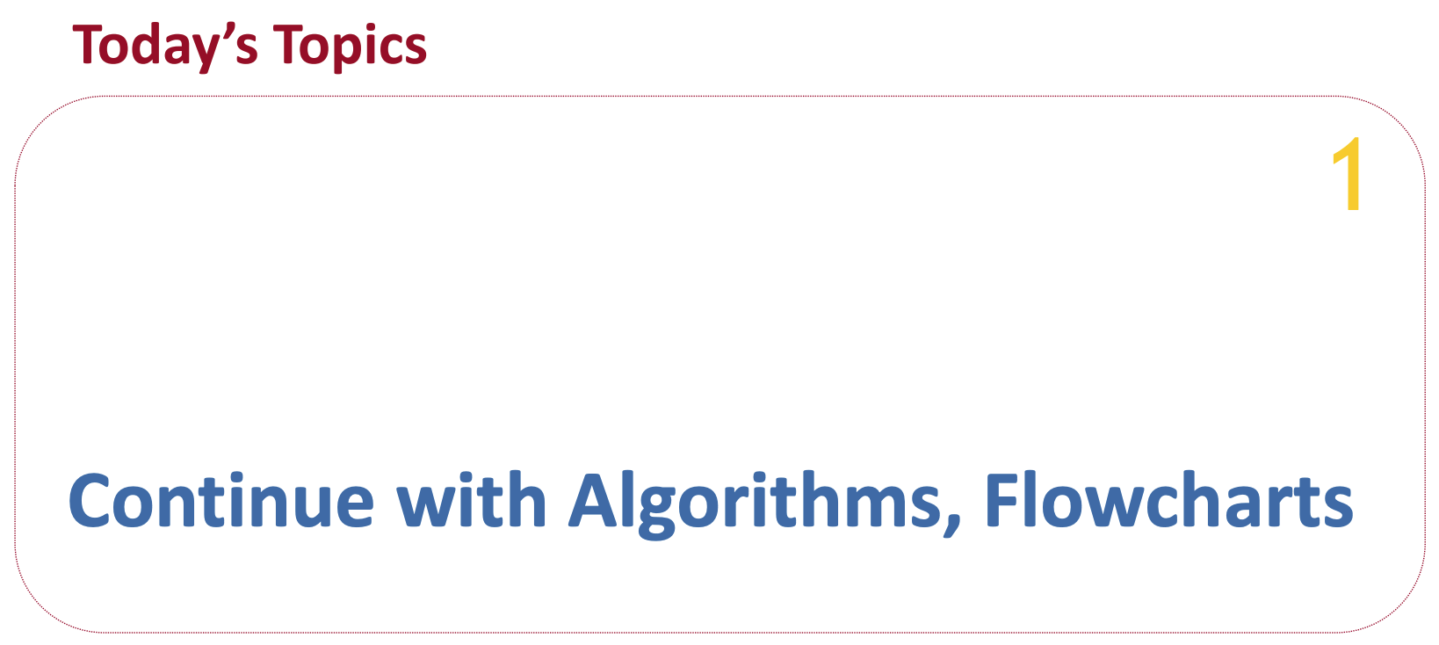

Slide 2
What is Flowchart?
A flowchart is a diagram that depicts a process, system, or computer algorithm. It visually represents the steps of a sequence in a clear, easy-to-understand format.

Slide 3
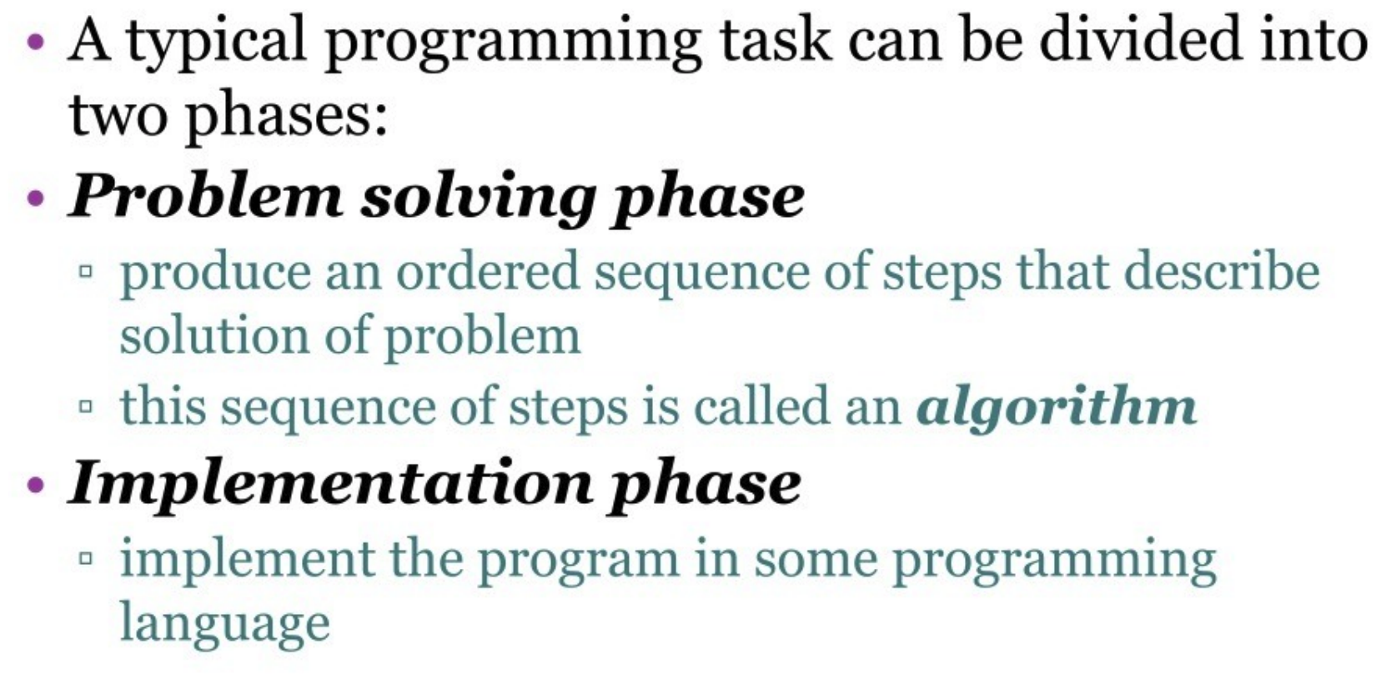

Slide 4
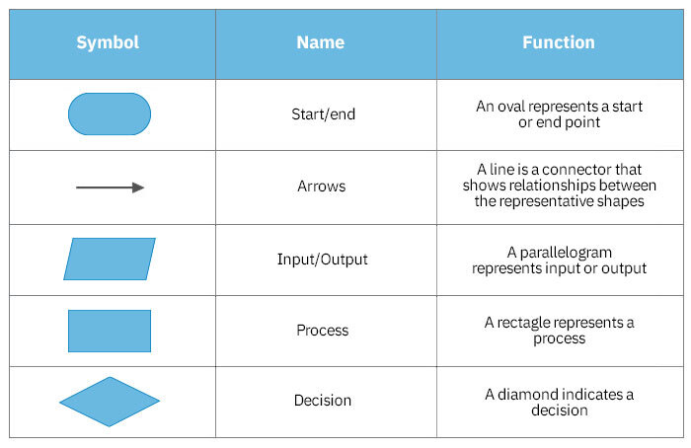

Slide 5
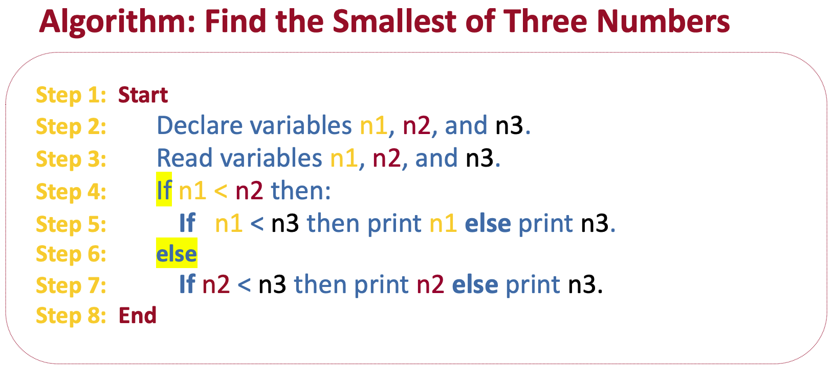

Slide 6
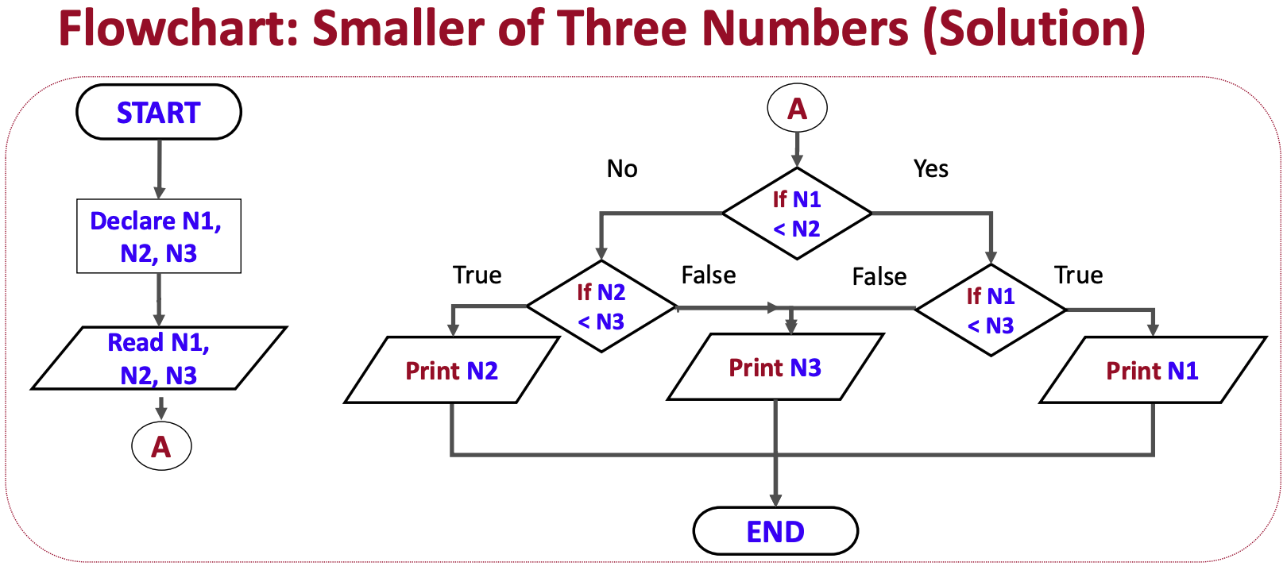

Slide 7
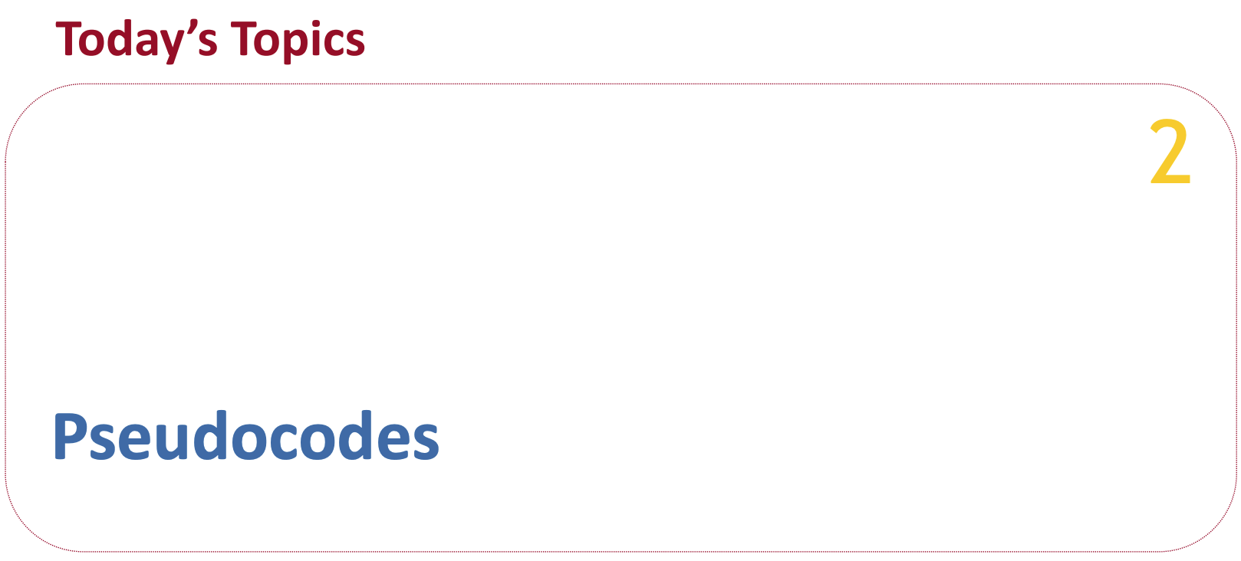

Slide 8
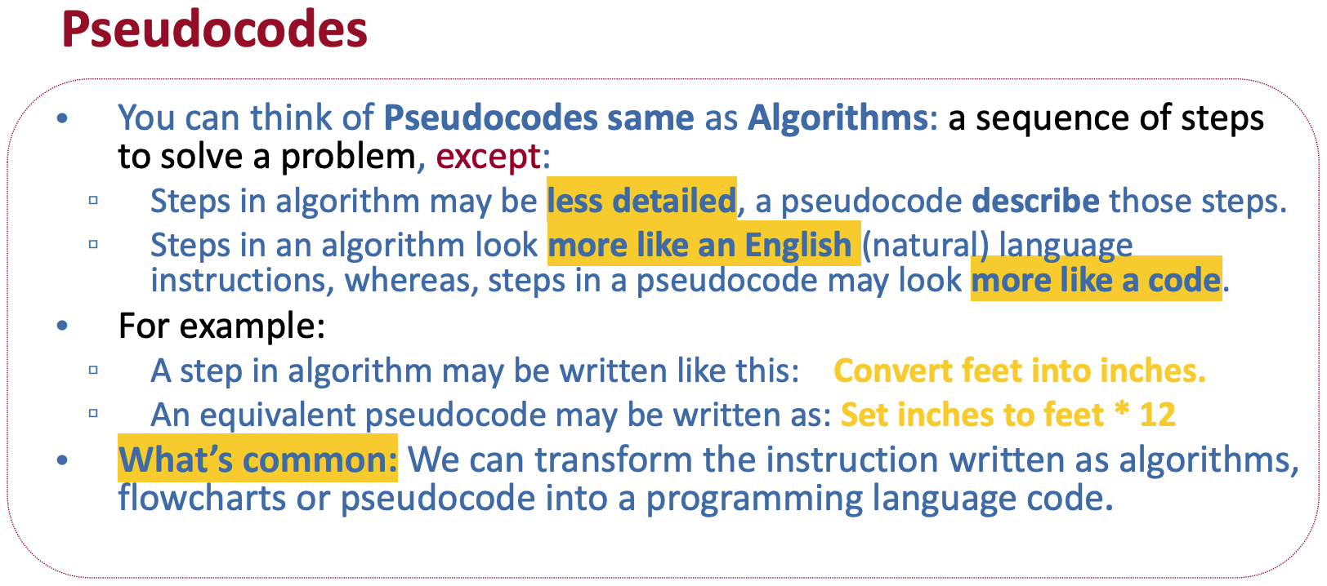

Slide 9
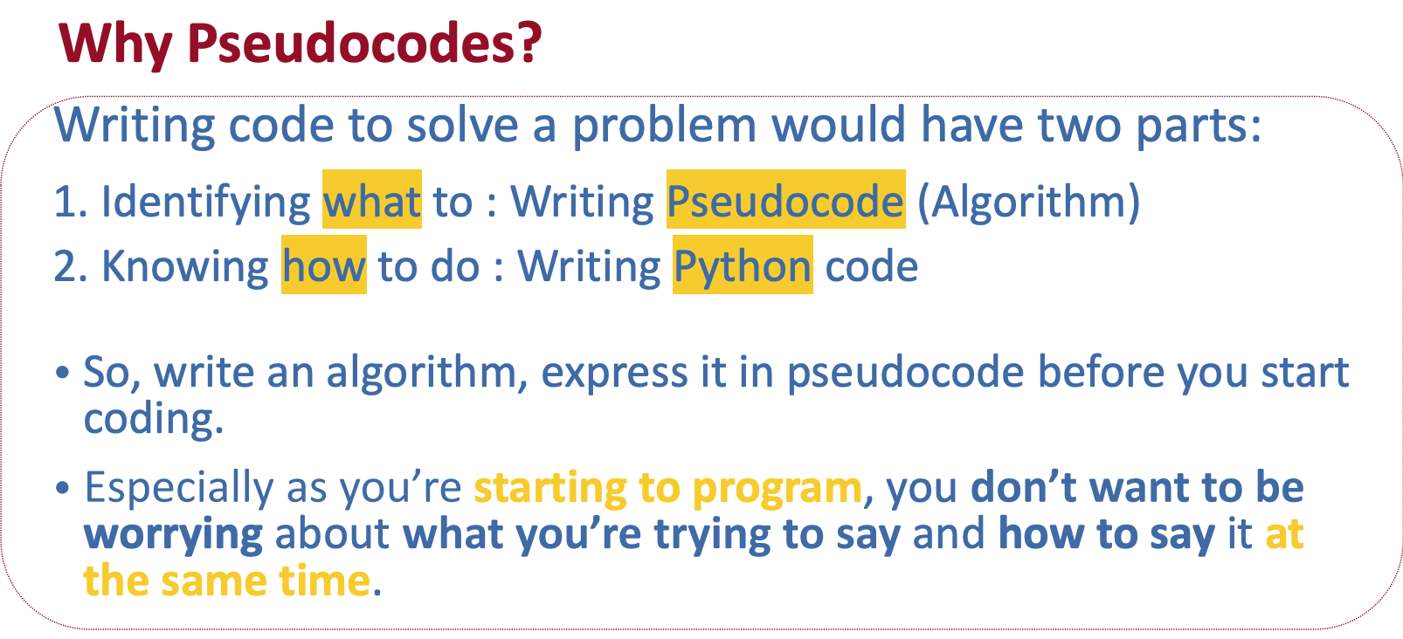

Slide 10
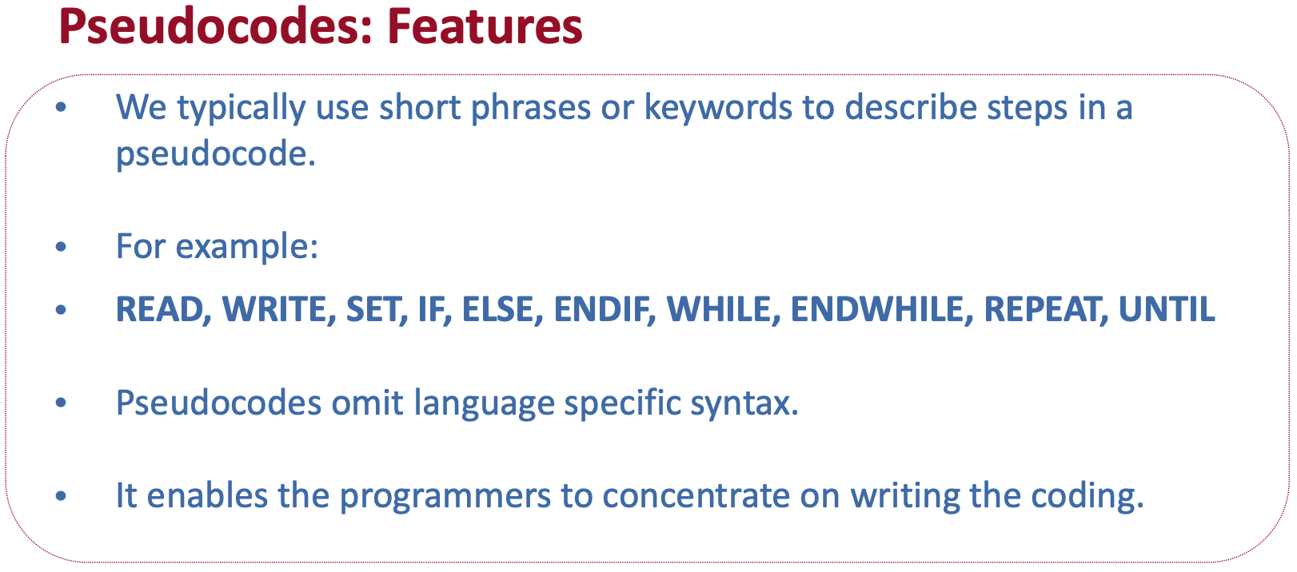

Slide 11
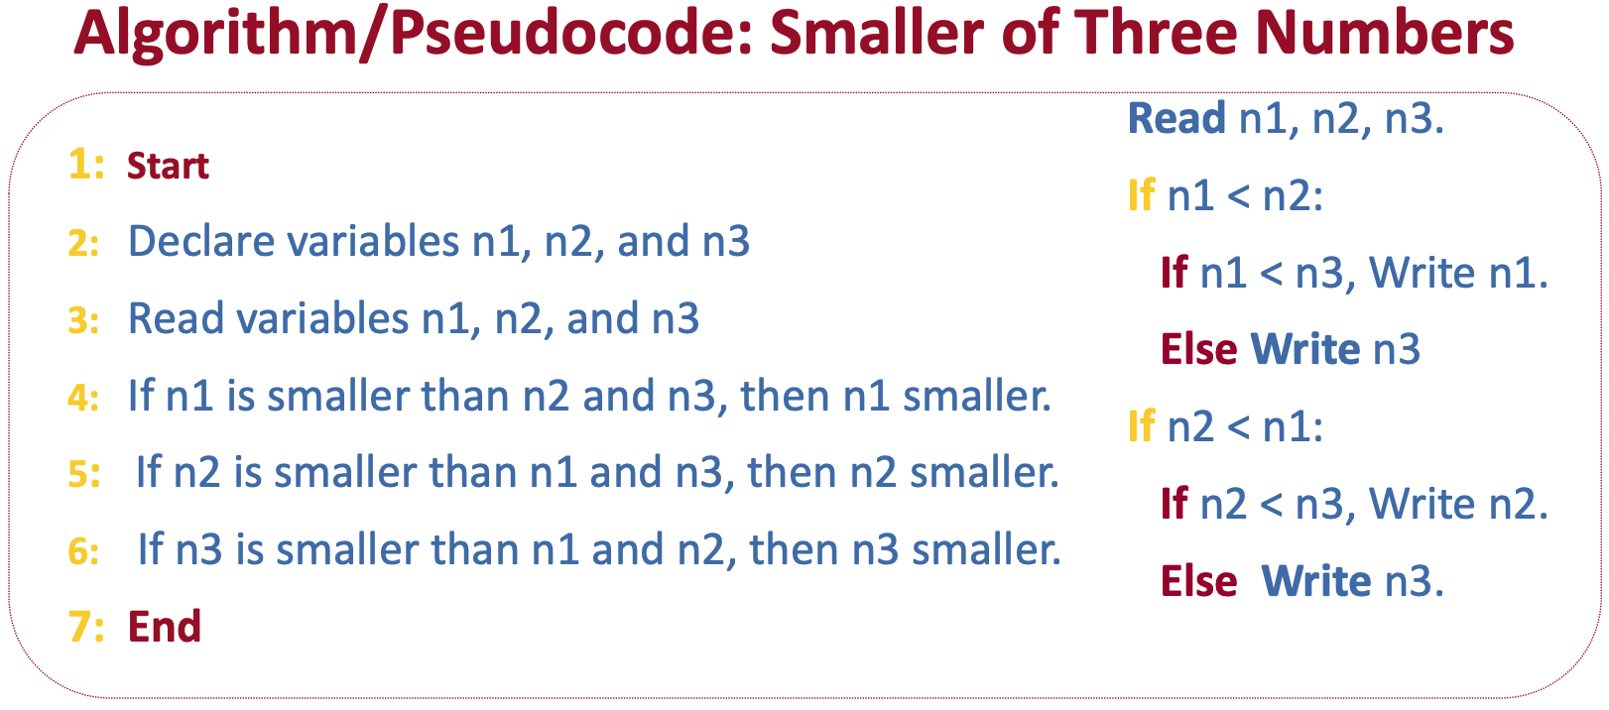

Slide 12
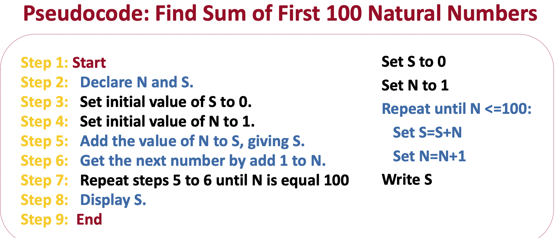

Slide 13
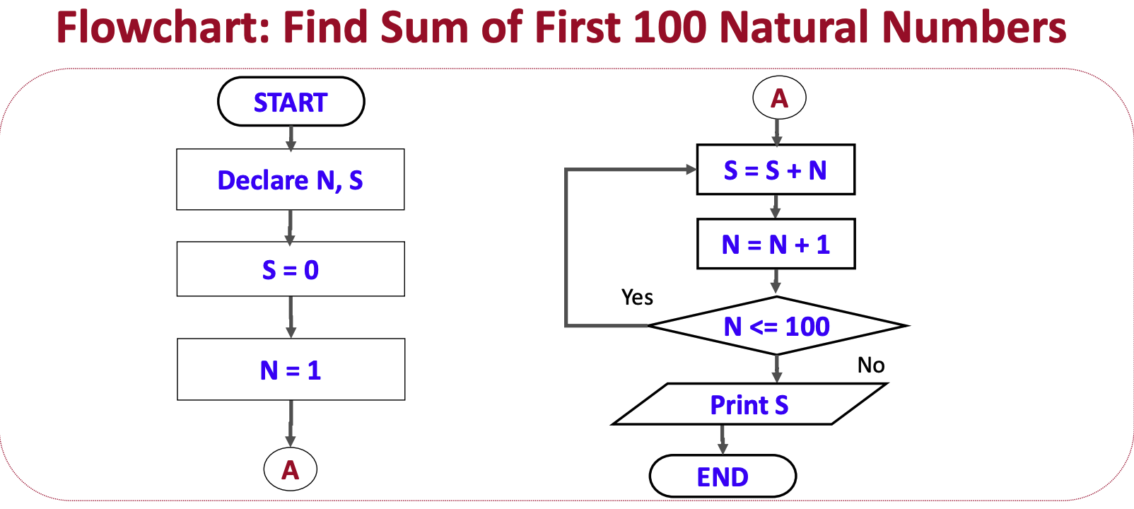

Slide 14
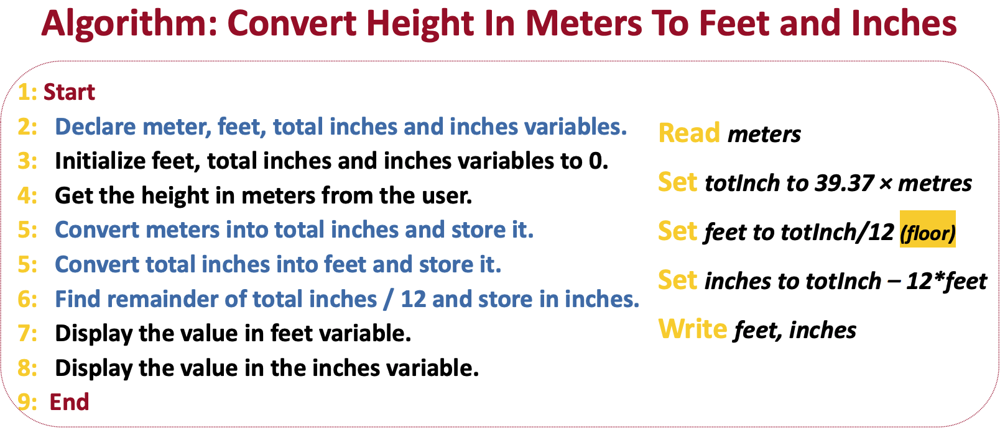

Slide 15
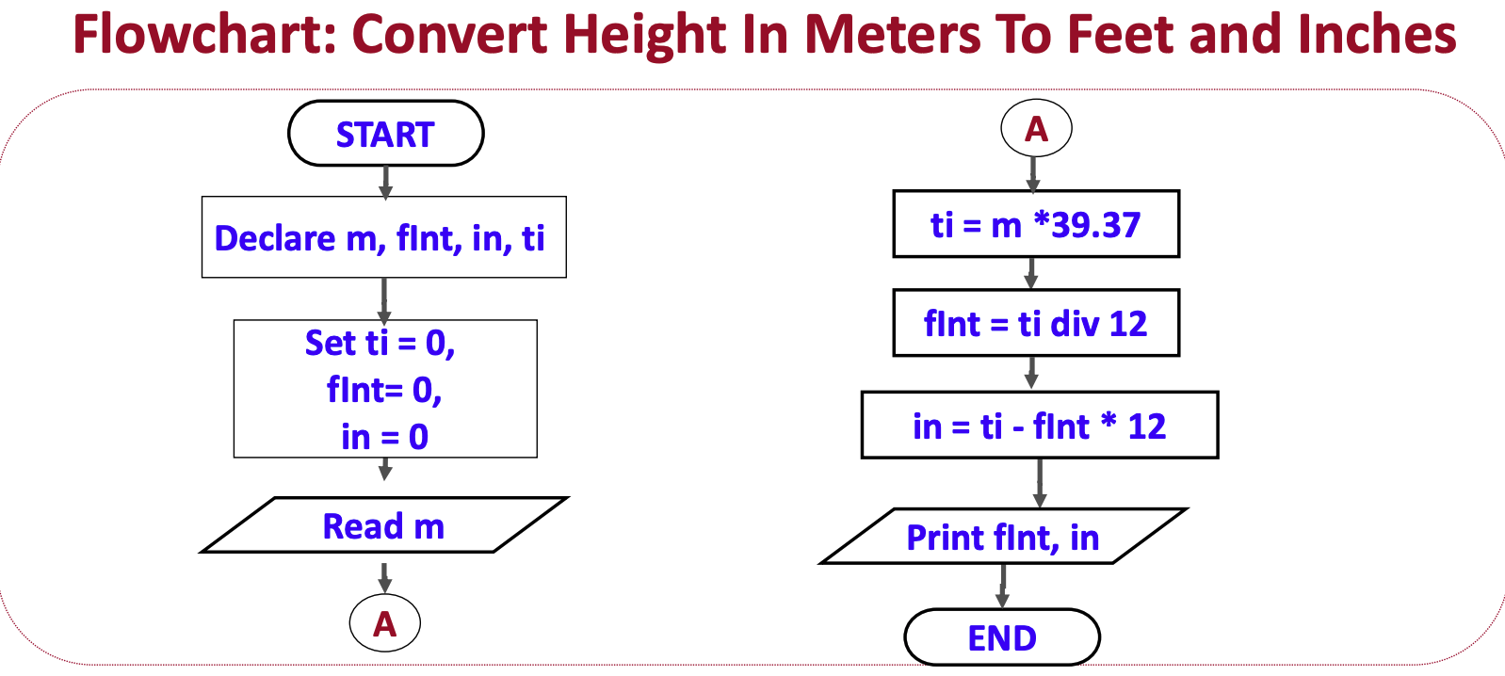

Slide 16


Slide 17
State whether given statements below are True or False
An algorithm is a step-by-step procedure to solve a problem.
Flowcharts use shapes like rectangles to represent processes or actions.
Flowcharts can only be used to describe computer programs.
Algorithms are only used by scientists and engineers.
Flowcharts must always flow from left to right.
Flowcharts can use arrows to show the flow of control in a program.
An algorithm must have exactly 10 steps to be effective.
Flowcharts are used to represent complex data structures.
Algorithms are used in everyday tasks like making a sandwich.
Flowcharts are a visual representation of an algorithm.

Slide 18
Match the following
1. Algorithm | A. Flowchart symbol that marks the beginning or end of a process
2. Flowchart | B. Step-by-step procedure to solve a problem
3. Process | C. Flowchart symbol that indicates a choice or condition
4.Decision | D. Action or step in a flowchart represented by a rectangle
5.Start/End | E. Visual representation of an algorithm using symbols and arrows

